Slide 1
GA Crime Analysis
Kendall Roberts
CS 2316
Georgia Tech

Slide 2
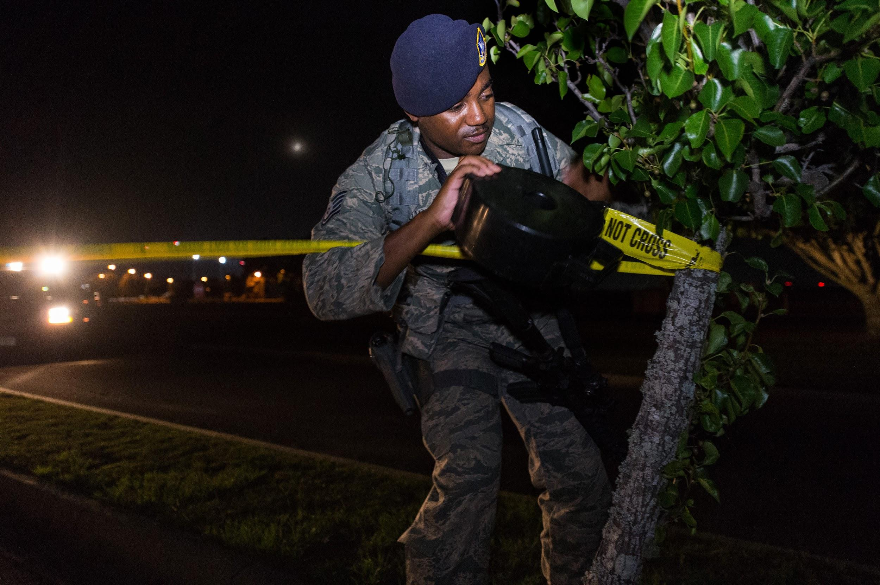
Point of Interest/Purpose
In recent years crime has been on the significant rise
Why do certain crimes seem to be left unsolved?
What crimes seem to occur the most often and what effect does waiting to report a crime affect this?
How does Wealth and Location play into this?
Want to discover what factors go into handling of crime

Slide 3

Data Collection and Data Cleaning

Slide 4
Data Collection # 1
The Downloaded dataset comes from the atlanta police crime raw data from the years 2009-2019
Link: https://www.atlantapd.org/i-want-to/crime-data-downloads
It contains Location data like address, latitude, longitude, neighborhood
It also contains report and occur date/times along with crime type, Shift, police beat, etc.

Slide 5
Data Collection # 2
My second dataset was the FBI crime data api
Link: https://crime-data-explorer.fr.cloud.gov/pages/docApi
It contains various information like the offense type, agency number, state, and actual and cleared crimes.

Slide 6
Data Collection # 3
For the third dataset I used a html source with the 10 wealthiest zip codes in the Atlanta area
Link: https://www.zipdatamaps.com/economics/income/agi/metro/wealthiest-zipcodes-in-metro-atlanta
It contains information like zipcode, zipname, county, grossincome, and median Household income.

Slide 7
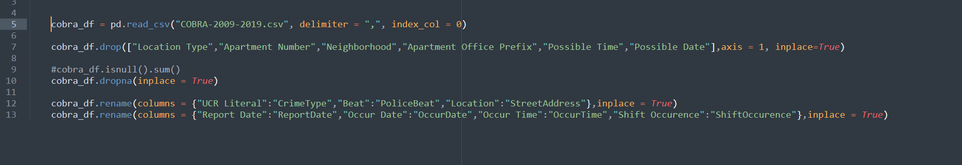
Data Collection # 1 Cleaning
Used pandas to clean the data
Used cobra_df.isnull().sum() to find columns with lots of null data then dropped them
Renamed confusing column names to more informative column names
Dropped rows which contained null data

Slide 8
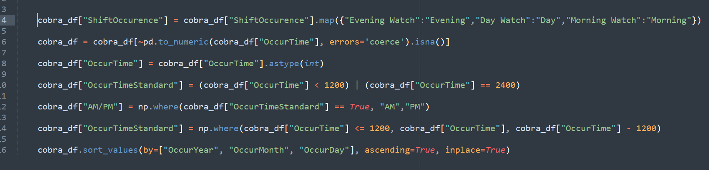
Data Collection # 1 Cleaning Continued
Renamed various elements to be shorter
Removed null/empty values from OccurTime and converted it to int type
Creates an AM/PM column based on the time in OccurTime
Sorts values by created columns OccurYear, OccurMonth, then OccurDay

Slide 9
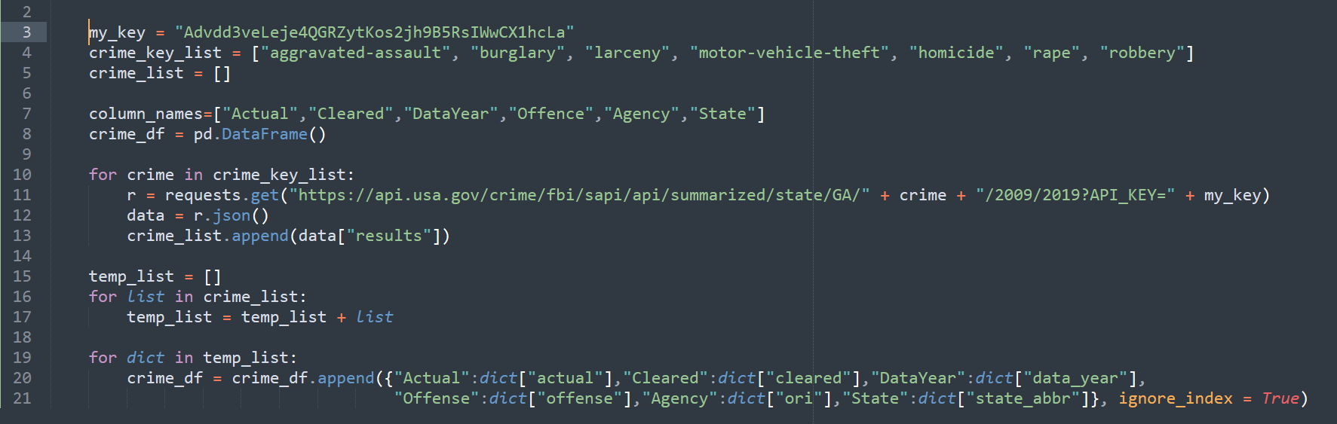
Data Collection Cleaning # 2
Used requests to get the api call results
Iterate through different crime keywords and converts the results to a dictionary
Reduced the data from a list of lists of dicts into a list of dicts
Adds the dicts to a dataframe called crime_df and renames some of the columns

Slide 10
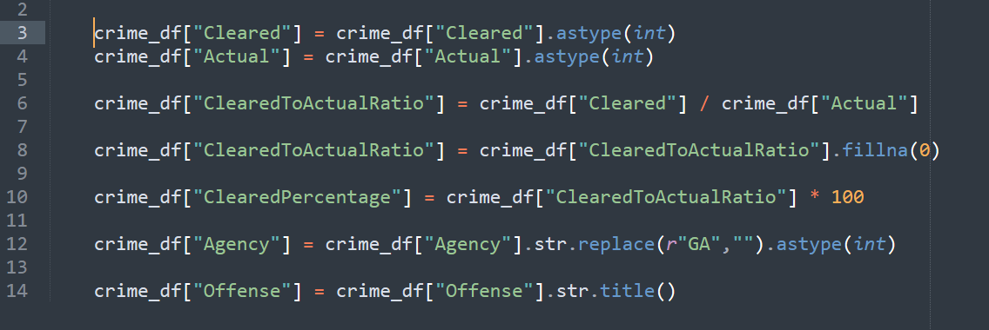
Data Collection Cleaning # 2 Continued
Created a column with the ratio of cleared cases to actual cases
Created a column with the percentage of crimes cleared
Uses regex to remove GA from agency column and converts it to int type
Converts the values in Offense column to uppercase

Slide 11
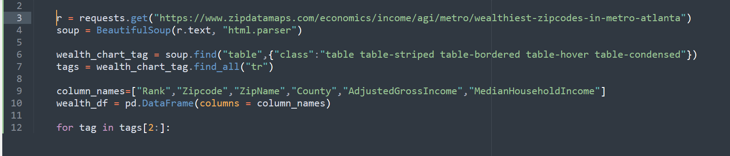
Data Collection Cleaning # 3
Used requests to get data and beautifulsoup to parse it
Used .find() to find table tag and find_all() to find all tr tags
Created a dataframe called wealth_df then iterates through the tr tags

Slide 12
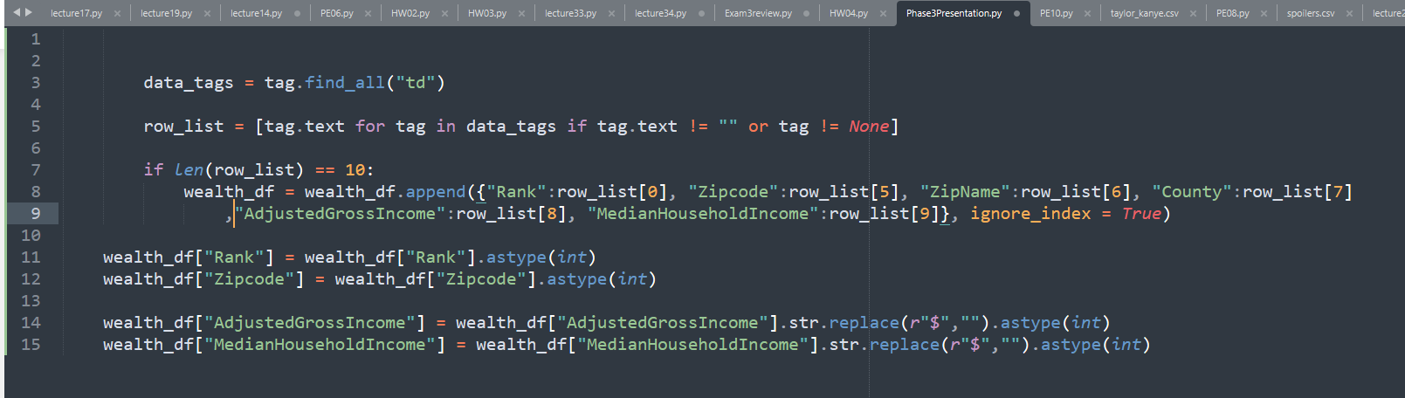
Data Collection Cleaning # 3 Continued
Uses find_all to find all relevant td tags
Created a list comprehension that converts the tags to text if they are not null
Adds the values from the list if they are the correct length
Converted relevance columns to int and used regex to remove $ in front of certain values and convert the corresponding column into int

Slide 13
Data Analysis

Slide 14
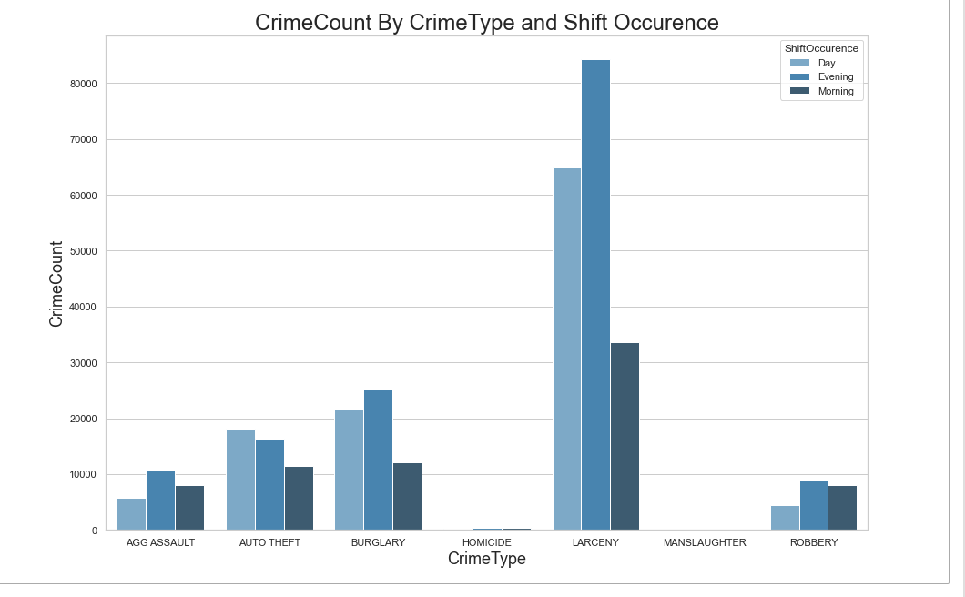
Insight 1
Most crimes occur during the evening with Larceny being the most common crime reported.
Larceny drops drastically during the morning with it being less than half of the Day Total. there is a drastic increase in robbery during the morning shift with it even passing the Day Shift.
Relative lack of homicide and manslaughter which suggests these crime types are very rare when compared to the other crime types

Slide 15
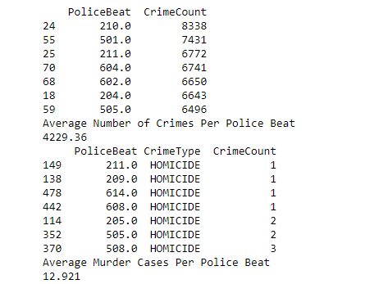
Insight 2
Average Police Beat has had 4229.36 crimes reported between 2009 and 2019.
Average amount of Homicide crimes reported was only 12.921 which is extremely surprising since this data covers ten years of report data with 342,578 individual crimes being tallied here.

Slide 16
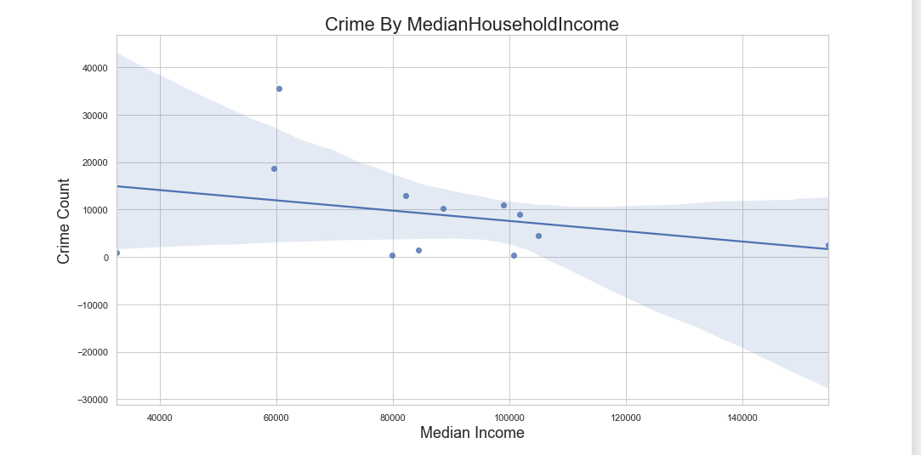
Insight 3
There is a noticeable negative correlation between both Gross Income and Median HouseHold Income and crime amount. I find this result a little bit surprising as I expected more crime in wealthier areas specifically robbery, theft and larceny. This to me suggests that possibly wealthier area report less crime.

Slide 17
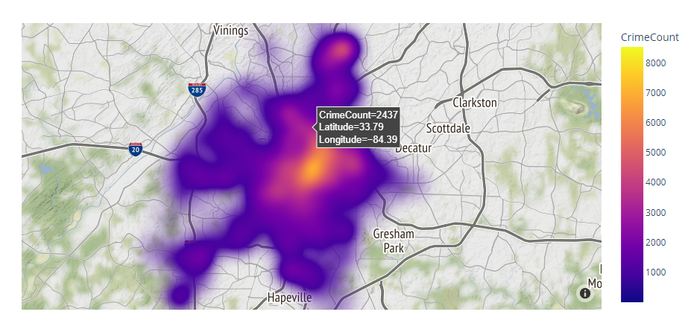
Insight 3 Continued
The second visual here is a density map showing the density of crime amount in the Atlanta area. If you mouse over the map you will see the crime amount along with the general lat/long correspondingly. There seems to be more crime the further into atlanta you go with a noticeable northward branch.

Slide 18
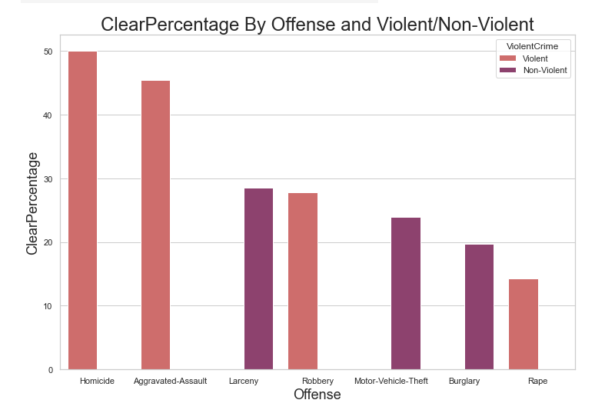
Insight 4
Average clear rate for crimes for each agency is only 35.59% which is shockingly low.
Violent crimes tends to have a higher clear percentage generally with a noticable exception of rape. I find this exception very strange since it has the lowest clear percentage of all offenses which leads me to the conclusion that there may be a significant issue with how agencies deal with rape crimes.

Slide 19
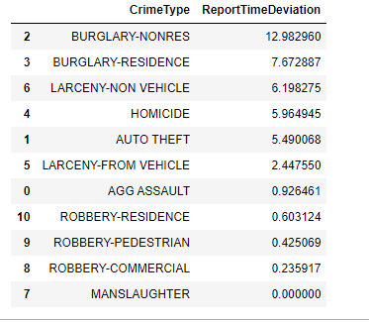
Insight 5
The average time deviation between reporting a crime and it occuring is 4.6239 days
Robbery has a significantly shorter time deviation when compared with burglary which to me suggests that the more violent crimes have a faster report time noting that the manslaughter row shouldn't be considered due to very small sample size.

Slide 20
Conclusion
More violent crimes tend to get reported faster and more likely to get cleared while non-violent crimes tend to take longer to get reported and get cleared less
Wealthier areas tend to have lower reports rates for crimes
The evening has the most crimes occur with specifically Larceny being the most common
Very low clear rate for agencies for rape which suggest issue with how agencies handle rape cases

Slide 21
Overall Experience
The greatest challenge for me was trying to clean the api dataset and trying to figure out a way to convert latitude longitude pairs to zipcodes
Overall this was a great experience

Slide 22
Thank You

